Slide 1

eta etacriticCritic
Jarvin Bayona
This Photo by Unknown Author is licensed under CC BY-SA
Notes:
Hello and thanks for having me.

Slide 2
Objective: Sell more games
Games are costly who should we cater to?
This Photo by Unknown Author is licensed under CC BY-SA
Notes:
Game developers spend a lot of time and money to sell their games, and publishers spend a lot more money to make sure they make money. If publishers want to make more money, one way of doing so is ensuring they sell more games. Games nowadays, like movies, are heavily criticized, and that is potentially an avenue that can help increase or decrease sales of a game. But who are these critics? Who should they tailor their games to?

Slide 3




This Photo by Unknown Author is licensed under CC BY-SA
This Photo by Unknown Author is licensed under CC BY-SA
Notes:
You have the professional critics. They’re the people who do in depth research, put together articles, and can get fairly deep level access to game company intel.

Slide 4


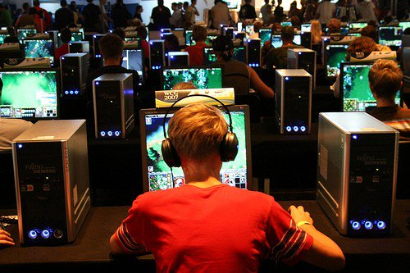
This Photo by Unknown Author is licensed under CC BY
This Photo by Unknown Author is licensed under CC BY-SA
Notes:
Then you have the gamers who are willing to give their two cents. The average joe. Or the pro gamer. Or just some guy at a LAN tournament.

Slide 5
Objective: Sell more games
Games are costly who should we cater to?
What kind of games might we try to make?
This Photo by Unknown Author is licensed under CC BY-SA
Notes:
Another thing we can look at is what kind of games to make.

Slide 6
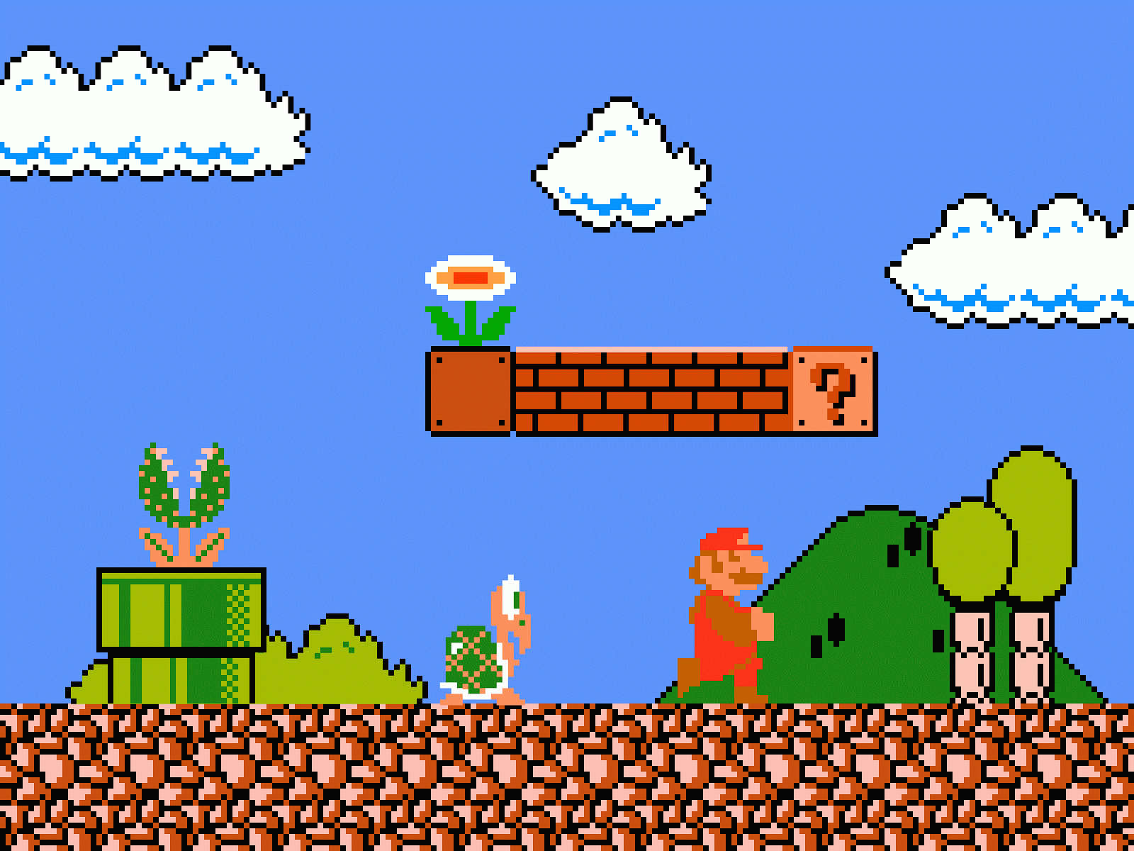
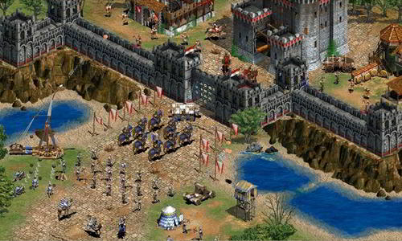






This Photo by Unknown Author is licensed under CC BY-NC-ND
Notes:
There are so many genres of games a team can make. Platforming, racing, arcade, RTS, fighting, even dating sim games. Would any of these be more popular or more of a moneymaker than the other? Would chess be better?

Slide 7









Methods, Data, Tools
Scraped data from two websites: Metacritic and VGChartz
This Photo by Unknown Author is licensed under CC BY-SA
Notes:
In order to study this, I scraped and cross referenced these websites. Metacritic is a website that collects ratings from professionals and users, as well as reviews. VGChartz is a website that has a database of game information. For this project, I used their units sold or shipped metric to determine the success of a game.

Slide 8
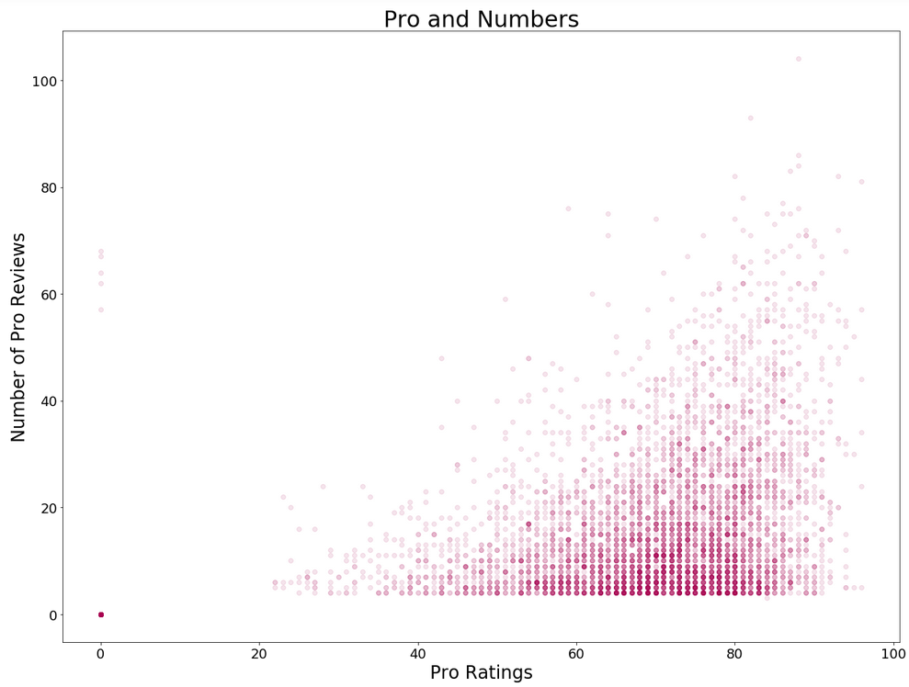
Notes:
Another thing I noticed while looking at the numbers is that Critic Ratings acted in an almost quadratic fashion with many variables. This made me think that perhaps having this feature squared would help build a model to evaluate.

Slide 9
Applied linear regression models, what do I get?
R² | .174
R² adj | .170
R² | .227
R² adj | .137
Plain features
Engineered features
Notes:
The metric I chose to determine a better model was R² and adjusted. After normalizing/scaling the features and applying the linear regression models, these are the results I got. As you can see, the engineered features don’t perform better.

Slide 10

How about the coefficients?
Notes:
The coefficients were crazy. Between the engineered and non-engineered model, I’d have opposite coefficient values. They were all over the place.

Slide 11
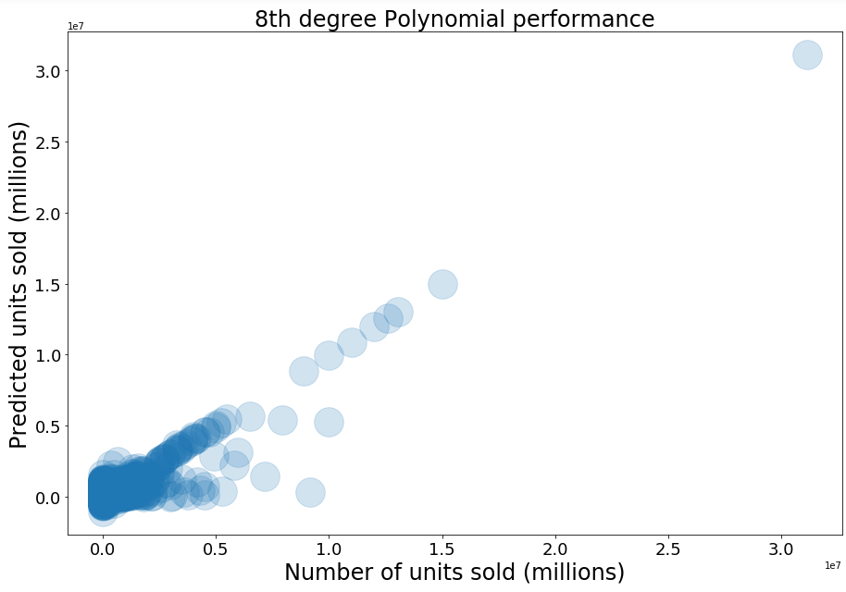
Different model, different outcome?
Notes:
I tried to apply polynomial regression to see if the model would perform better. Honestly, this is a poor chart choice. This graph shows that many predictions were equal to their test values, but on the whole, units that sold less than 100thousand were much harder to predict.

Slide 12
Conclusion:
PolyReg > LinReg
Notes:
So the conclusion is that polynomial regression was better for modeling than linear regression.

Slide 13
Conclusion:
 | coefficient | Standard deviation
Critic Rating | 2412.3722 | 954.006
User Rating | 2465.3722 | 2114.967
Notes:
The main point of this study was to look at who we should cater to more and what genre of game to make in order to sell more games. After LASSO regularization, I saw that the genre made had little to no correlation to the number of units sold. But looking at the critic and user rating coefficients, I saw that they were steady indicators. The professional critics are slightly less correlated than the users, but are more consistent. Of course the users would have more variation because there’s more of them.

Slide 14
For the future:
Get a better data set
Clean the data better
Find a better model to use
Notes:
In the future I’d like to improve by using either a better website or being handed data /sad/. I cut a lot of corners while cleaning the data, and may have messed up the regularization/ scaling a bit, so I want to go back and fix that. And I want to see if there’s anything better to use than a polynomial regression.

Slide 15

Notes:
Any questions?

Slide 16
Appendix

Slide 17
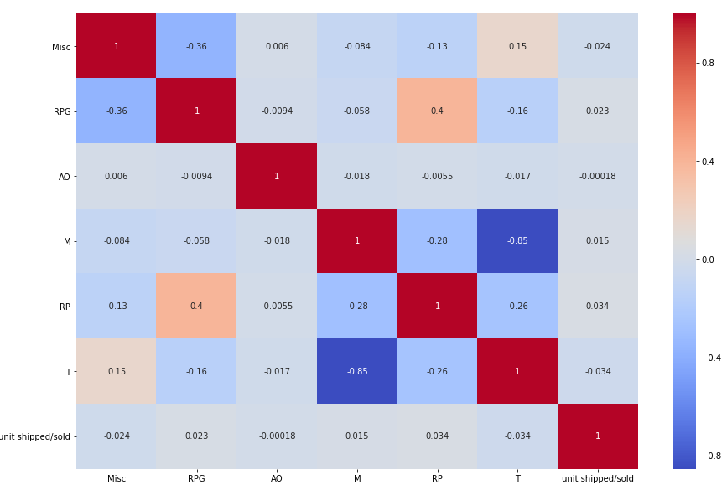

Slide 18

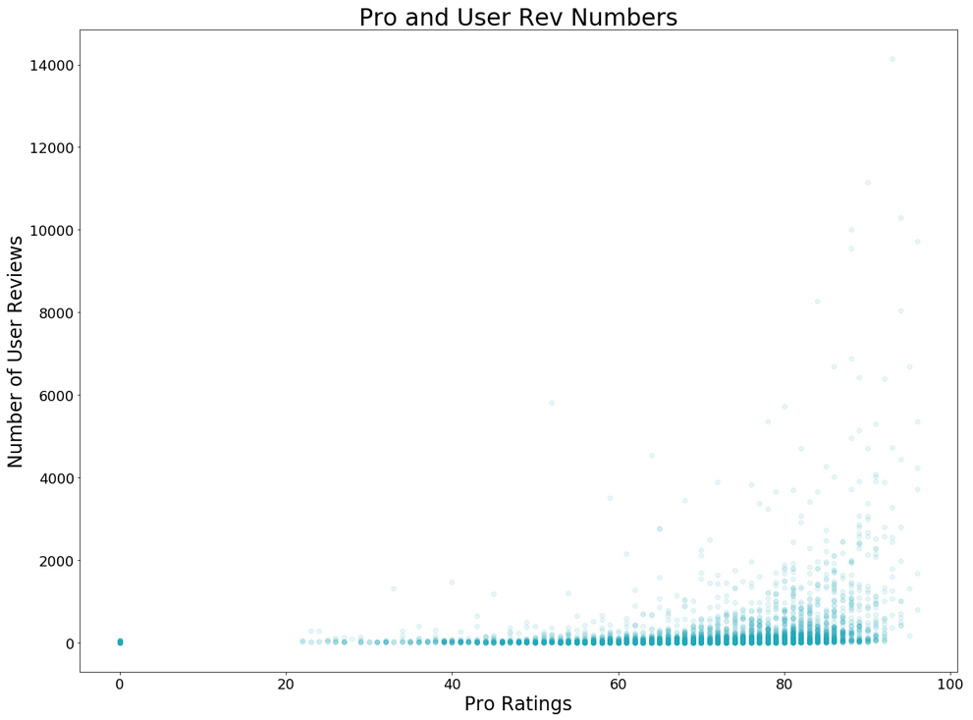

Slide 19
